Slide 1
E-Commerce Website for Automotive Parts
Name: Vishwalakshmi V (Enrollment No : EBEON1222725958)
Name : Kowsalya G (Enrollment No : EBEON1222724834)
Name : Srividhya A (Enrollment No : EBEON1222711097)
Name: Kanagavalli R (Enrollment No : EBEON1222707345)
Name: ARCHANA R (Enrollment No : EBEON1222714598)
Name: Susmitha S (Enrollment No : EBEON1222709710)
Guided by :
Mr. Vardharajan

Slide 2
Introduction
Auto Parts plus is an user friendly ecommerce website which provides users an option to buy any automotive parts for their vehicle from online, within few steps.
As an admin you will be able to add your on categories and product in the website which will be displayed to the user for buying.
We have also included an online payment option which will help user to pay for the products online itself.

Slide 3
Software and Hardware Requirements
Software Requirements
Eclipse IDE
Programming language- Java
Spring Boot.
JDK 17
Frontend - HTML, CSS, Bootstrap, java script.
Database - MySQL
Hardware Requirements
Processor - Radeon R4
Speed – 2.00GHz
RAM - 4GB (minimum)
Hard disk- 50GB

Slide 4
E-Commerce Website for Automotive Parts
Modules:
Homepage
Login and Registration
Shop
Cart
Payment
Admin Module
Stock Module

Slide 5
E-Commerce Website for Automotive Parts
Modules and Submodules
Stock Module.
Upload the product details to database
Upload the product image
We can see the all product in product section
Update the product detail that already uploaded.
It storing the product to maintained using of insert and delete processor in database

Slide 6
Continued...
Goal of module:
Stock maintenance is the place that view the details of product which were seen in the website.
Here we can upload the product and product details.
Get all the product detail from the database.

Slide 7
Stock Module
Definition:
Stock maintenance is the process of managing the goods your business plans.
This involves acquiring, storing, organizing and tracking those goods..
We can add new products, update and also delete the products by the category .
Sub module details :
Navigation Bar which has a connection with Stock maintenance
By this navigation bar we can directly go to Stock we need to update the products.
Module Interconnection details :
Here the navigation bar is present throughout the module so it is connected to Stock module and shop module.

Slide 8
Continued...
Sub module details
The View Products detail the page is a web page on an ecommerce website that provides information on a specific product. This information includes size, color, price, shipping information, and other relevant information customers want to know before purchasing.
Also editing the products like add, delete, update and modify the stock view products

Slide 9
Project overview
Admin
User Details
Add Category
Login
Add Product
Logout
Homepage
Shop
Stock
Chatbot
Payment
View Product
Add To Cart
Checkout

Slide 10
Tech architecture
1.)Data JPA Security
2.)Oauth2-Client
3.)Thymeleaf
4.)DevTools
5.)Web
1.)HTML
2.)CSS
3.)JavaScript
4.)BootStrap
1.)Java
2.)Spring Boot
3.)Hibernate concepts
Spring Boot
Browser
FrontEnd
BackEnd
Hibernate
MySQL
1.)Object Persistence
2.)Mapping with POJO
3.)Database Connection
1.)DDL
2.)DML
3.)DCL
4.)TCL

Slide 11
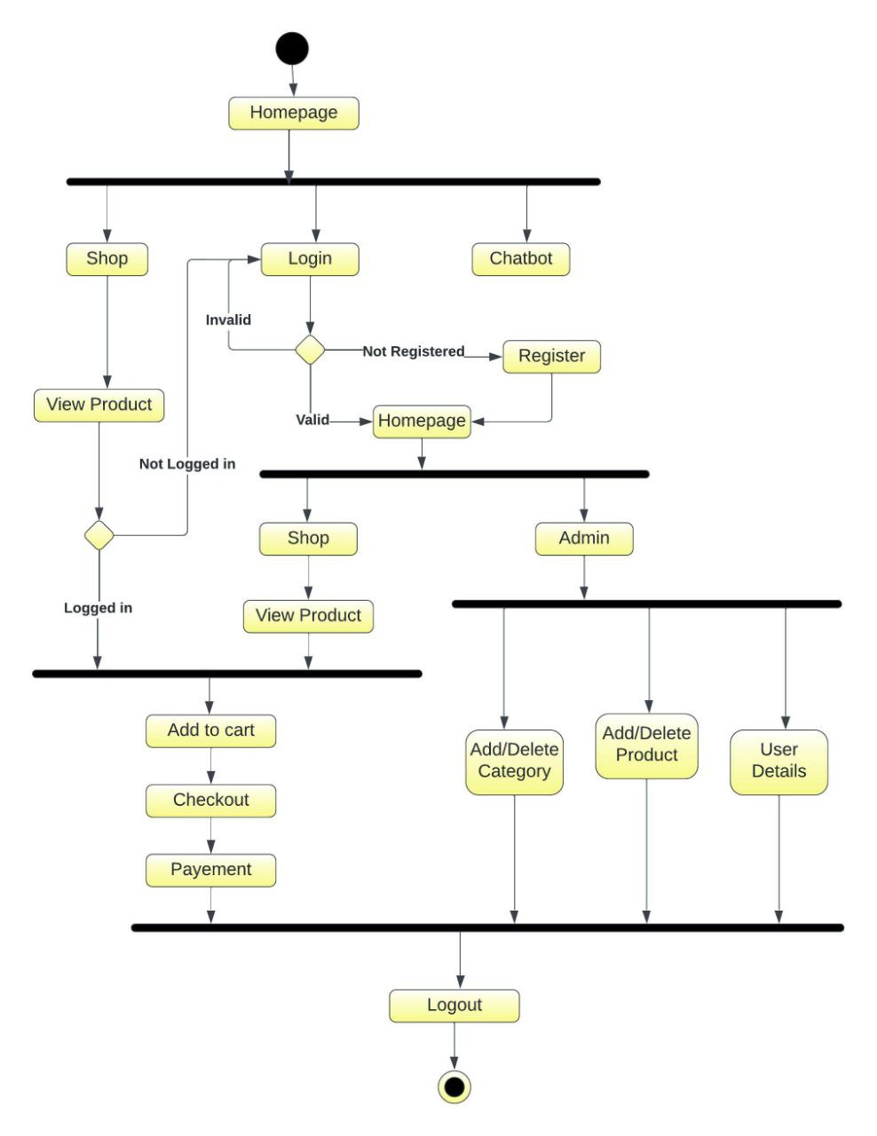
Activity diagram

Slide 12
Challenging issues
While showing the product details to the database, facing the mapping issues. This is resolved by checking properly.
Facing the error while adding the images ,but it did not reflect by refreshing the ide it will solved.
While showing maintenance table occur error was faced due to unnecessary or wrong references to css and js files. This error was resolved by giving the proper path to that specific files.

Slide 13
Features about the module
We can add the images and details of the products
We can see all the product and the category details here.
It has a user friendly interface, where the users will find it easy to use.
The chat bot is very helpful for the users
We can view the how many item have in this categories

Slide 14
Future enhancement
Integrate the product supplier details.
To add Sell product option, where user will also be able to sell their own products.
In chatbot we improve that with a aiml and NLP.
To maintain product in warehouse

Slide 15
Quality improvement task
Testing aprouch:
Junit basic test validation
DevOp tools:
MySQL Workbench, Github, Maven
UI approach
HTML, CSS, java script, Bootstrap.

Slide 16
Conclusion
In this project we have built an ecommerce website specially designed for automotive parts. With online payment and may more facilities.
Which has user friendly interface for easy use purpose.
We have implemented the CRUD operations with hibernate and spring boot for easy use of the project.
With this we conclude that this project has almost fulfilled all the basic necessities of an ecommerce website.

Slide 17
THANK YOU
Presented By :
Susmitha S

